Slide 1
Racism and Health
Leslie Gregory, PA-C
leslie@right2healthus.org
@RightToHealthUS

Slide 2
What is Right To Health?
A Portland-based non-profit founded in 2006 by Leslie Gregory focusing on preventative health management
Established Right To Health Now! in 2015, a nationwide campaign that demands racism be addressed at the federal level (CDC, NIH)
Join the campaign today: https://sign.moveon.org/petitions/racism-meets-criteria?r_by=16228964&source=c.fb
Committed to alleviating the ills of racism across all ethnic groups, with particular attention to Black Americans

Slide 3
Racism’s Toll on Health
PHYSICAL
MENTAL
Kids
Kids
Few due to adaptability
Sleep deprivation, opposition defiance, hyperactivity, verbal and developmental issues
Adults
Adults
Anxiety, depression, anger, substance abuse (food included!), PTSD
Hypertension, Diabetes,
heart disease, chronic pain,
chronic fatigue

Slide 4
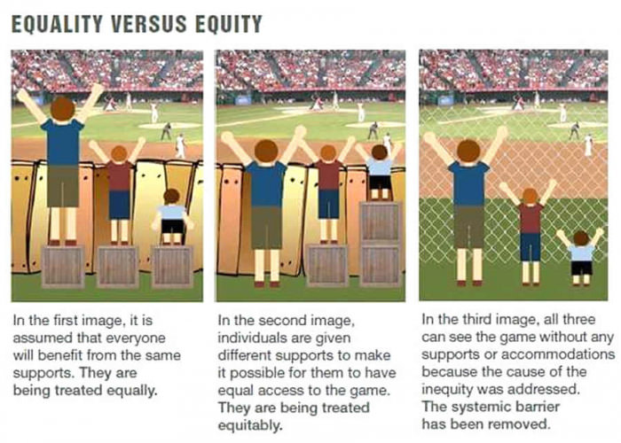
Equality vs Equity
Equality: Everyone benefits using the same supports to watch the game, but barriers exist (fence)
Equity: Different supports are given to make it possible for everyone to watch the game, but barriers exist (fence)
Barriers Removed: Everyone watches the game without any supports or accommodations: the cause of the inequity was removed

Slide 5
Goal of RTH Now!
The CDC (Centers for Disease Control and Prevention) should acknowledge, by its own criteria, that racism in America is a public health threat.
Solutions to combat racism must be addressed at a systemic level.

Slide 6
What is CDC’s Criteria?
Disease burden (in terms of mortality, morbidity, quality of life and cost) is high and getting larger despite current control efforts.
The burden must be unevenly distributed in terms of populations affected, less observed in majority-culture populations and much more in marginalized populations.
There must be evidence that system approach or “upstream”/preventive strategies could substantially reduce the burden.
Evidence demonstrates that such system strategies are not currently available.
Citation: Peer Reviewed Chronic Kidney Disease

Slide 7
The CDC should lead…
Everything has been tried
Prevention
CDC can engage and be an example for other institutions. ADA example.
Social determinates
Co-opted by culture
BLM
Regionality of racist expression
Racism effects everyone including white people. Correllary, fragile, anxious, don’t know its related to privilege, “politically correct”
poor whites are voting against interests, fear and greed based post supremacy fragility syndrome

Slide 8
…but they won’t step up
No patient zero (Tom Friedman is patient zero for racism)
Other social problems
Don’t(?) disproportionately affect a group
There has been no apology for other groups, there has been an official government apology for slavery. Joy DeGru Post Traumatic Slave Syndrome
Stigmatization… NO it’s racism

Slide 9
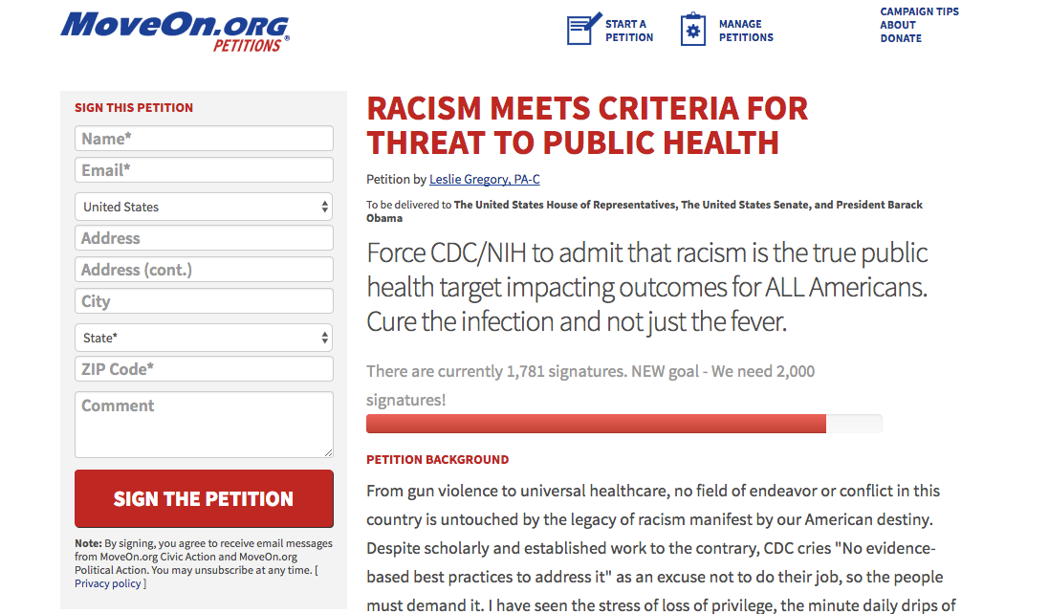
What YOU Can Do
Sign the petition on moveon.org: “Racism Meets Criteria For Threat To Public Health”…then SHARE!
Write to the CDC, your local representatives

Slide 10
Resources and Citation
Chronic Kidney Disease: A Public Health Problem That Needs a Public Health Action Plan https://www.ncbi.nlm.nih.gov/pmc/articles/PMC1563984/
CDC REACH Awardees http://www.cdc.gov/nccdphp/dch/programs/reach/current_programs/reach.html
Please add

Slide 11
Thank you
Join the campaign today: https://sign.moveon.org/petitions/racism-meets-criteria?r_by=16228964&source=c.fb

