Slide 1
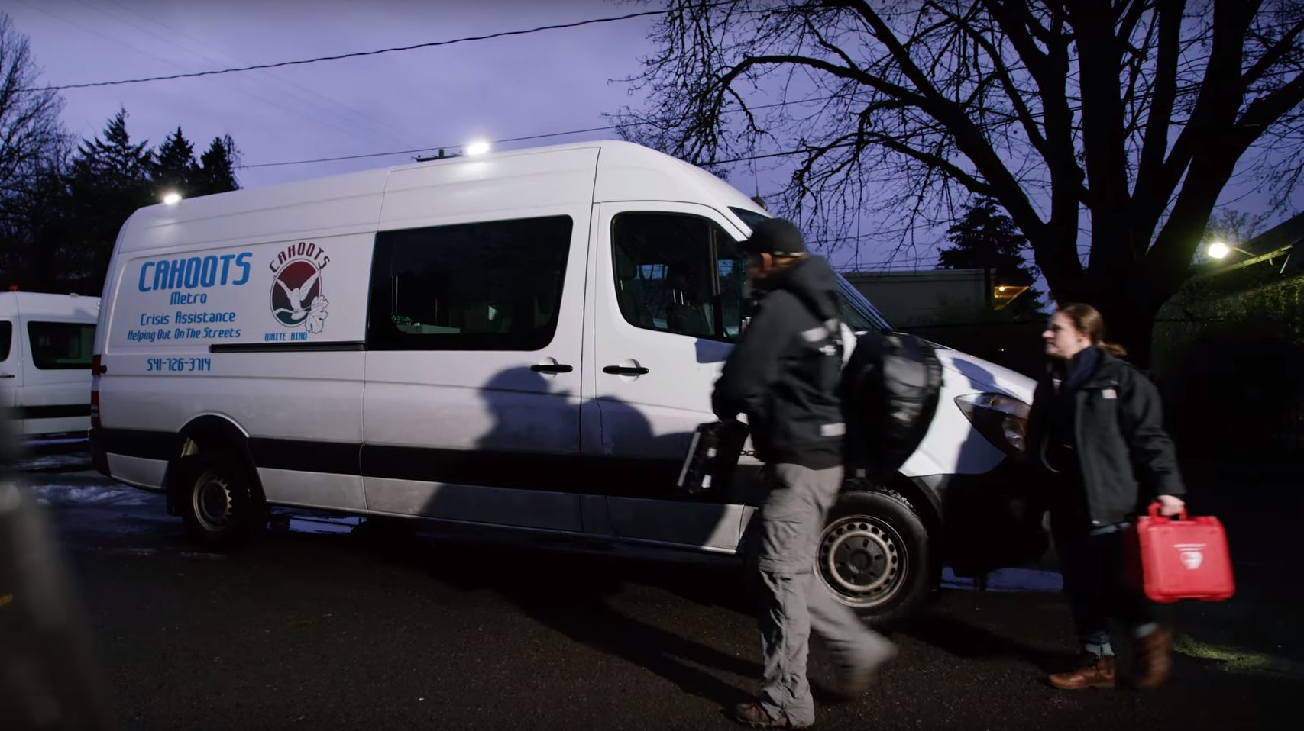

Slide 2
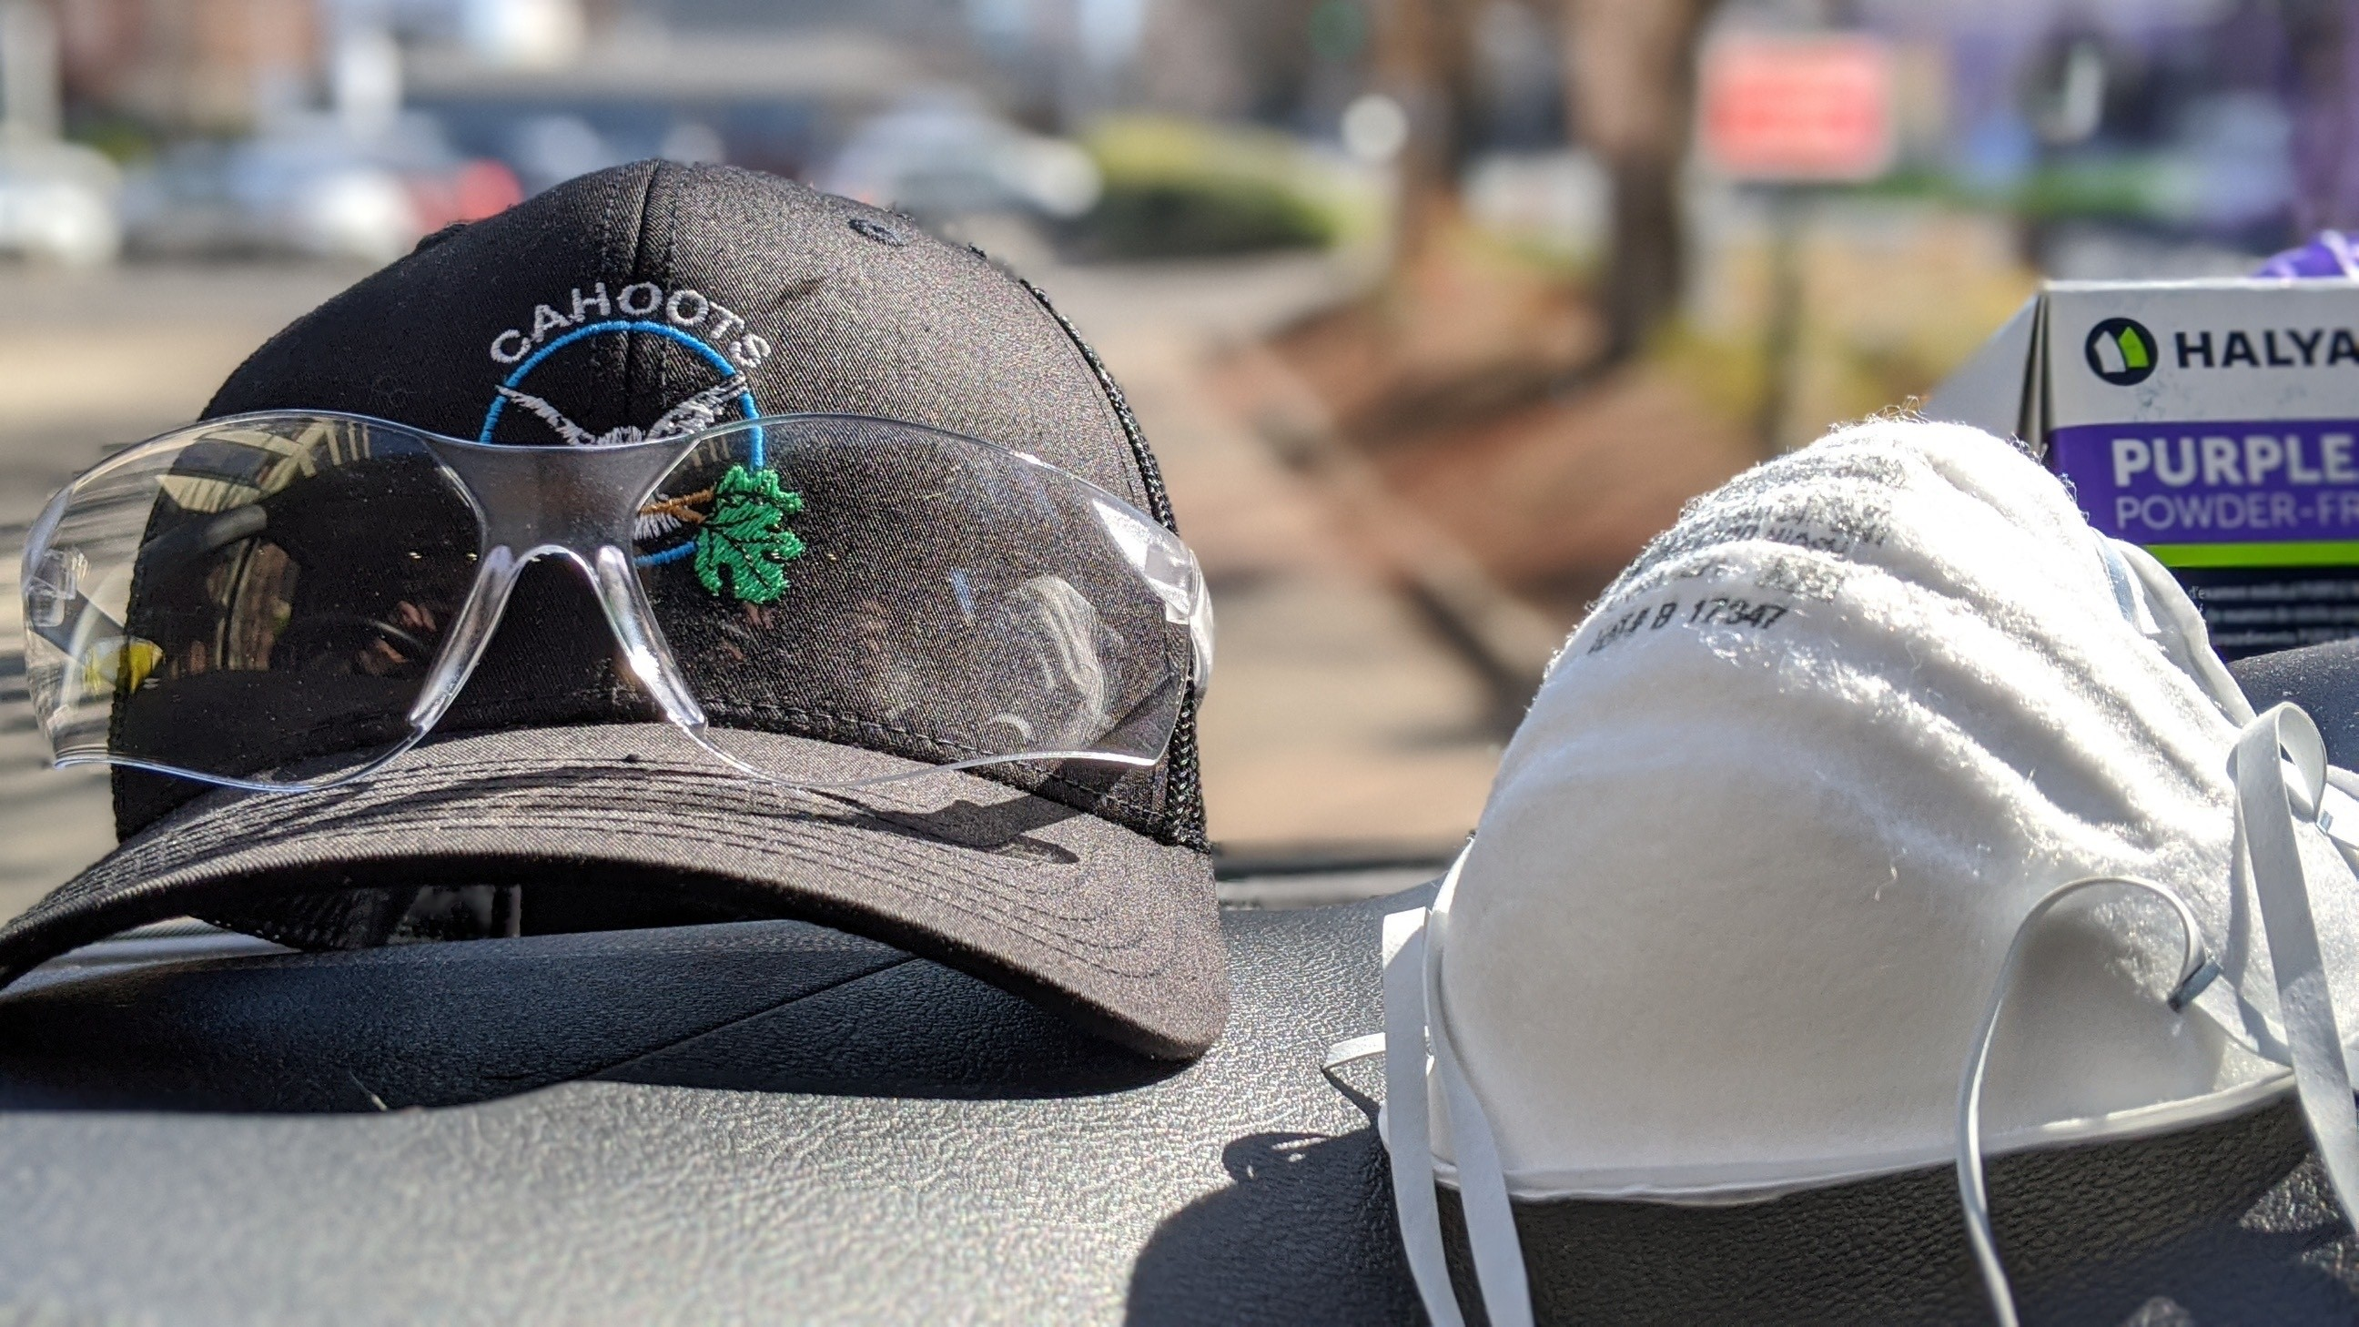

Slide 3
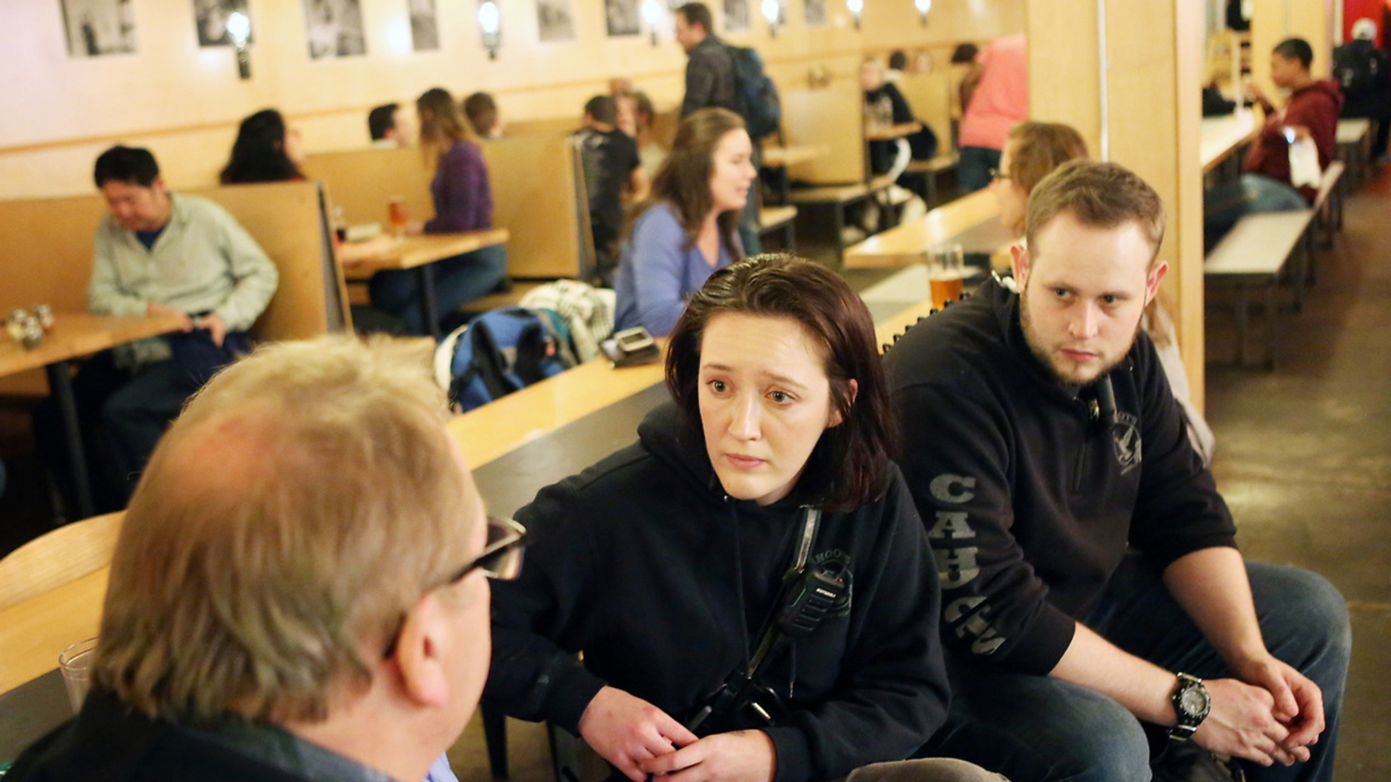
Photo Credit: Thomas Patterson

Slide 4
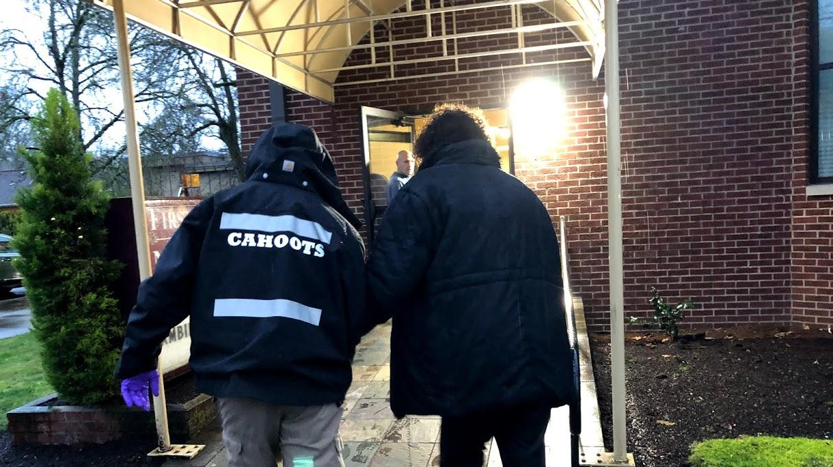
Photo Credit: Brian Bull, KLCC News

Slide 5
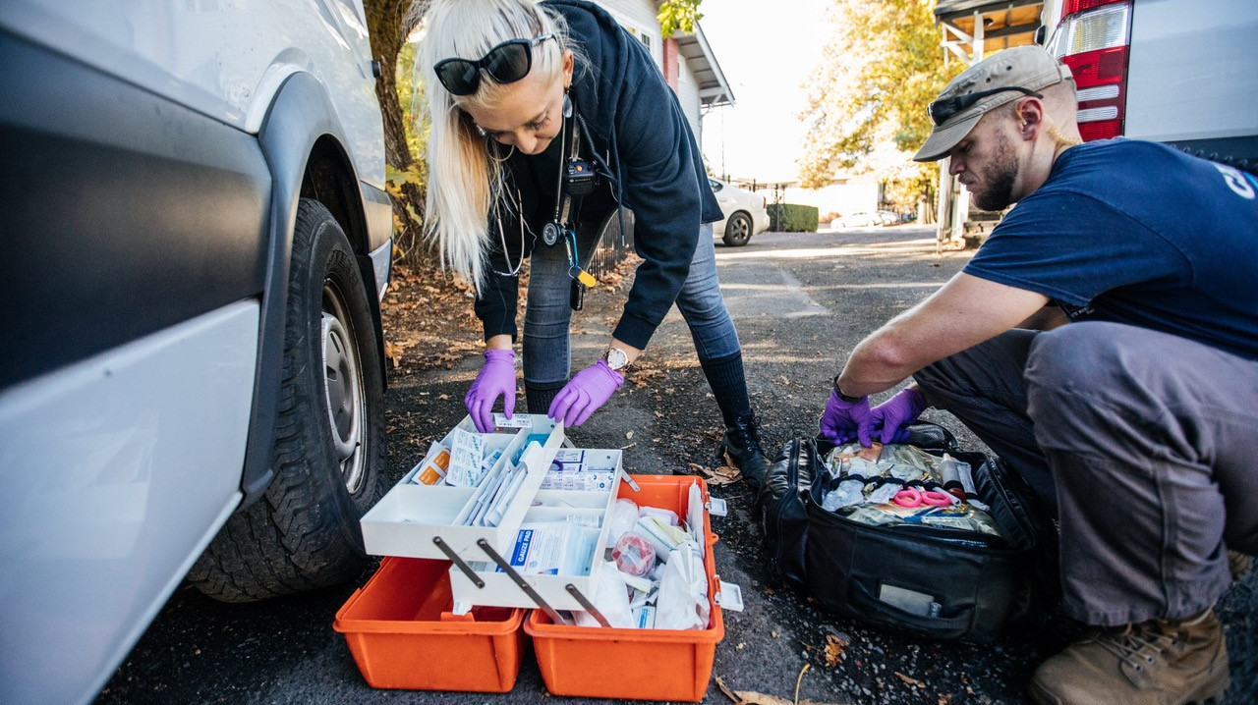
Photo Credit: Todd Cooper, Eugene Weekly

Slide 6
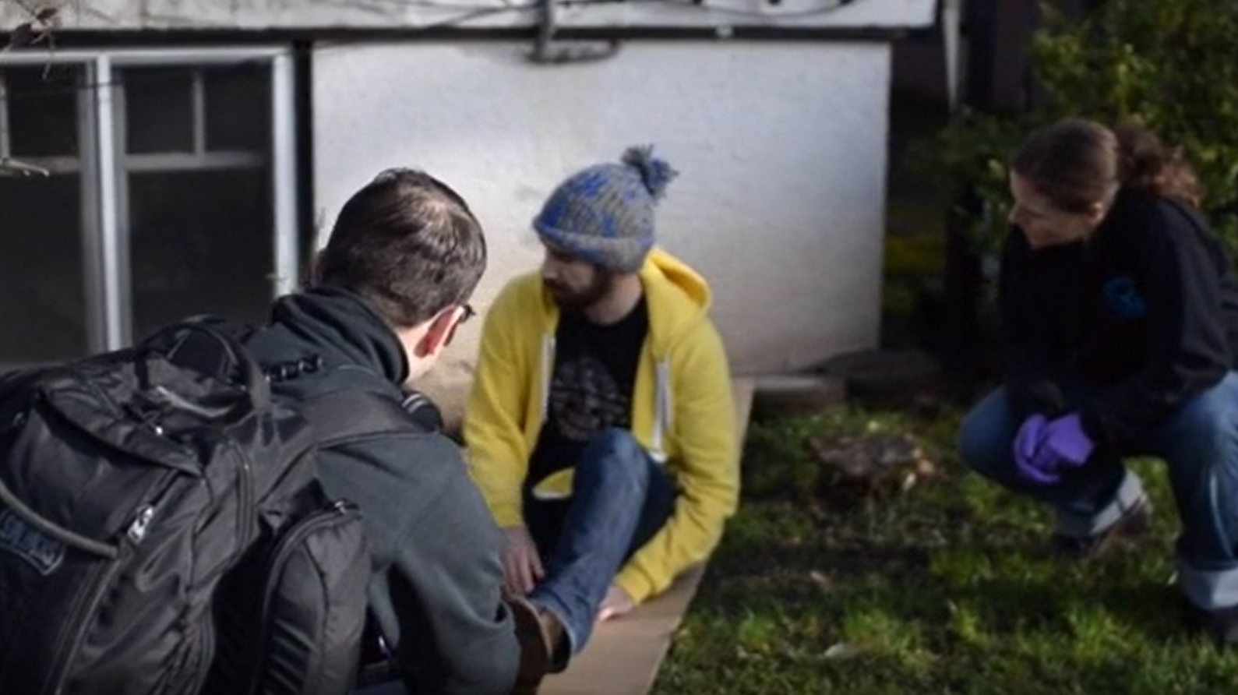

Slide 7
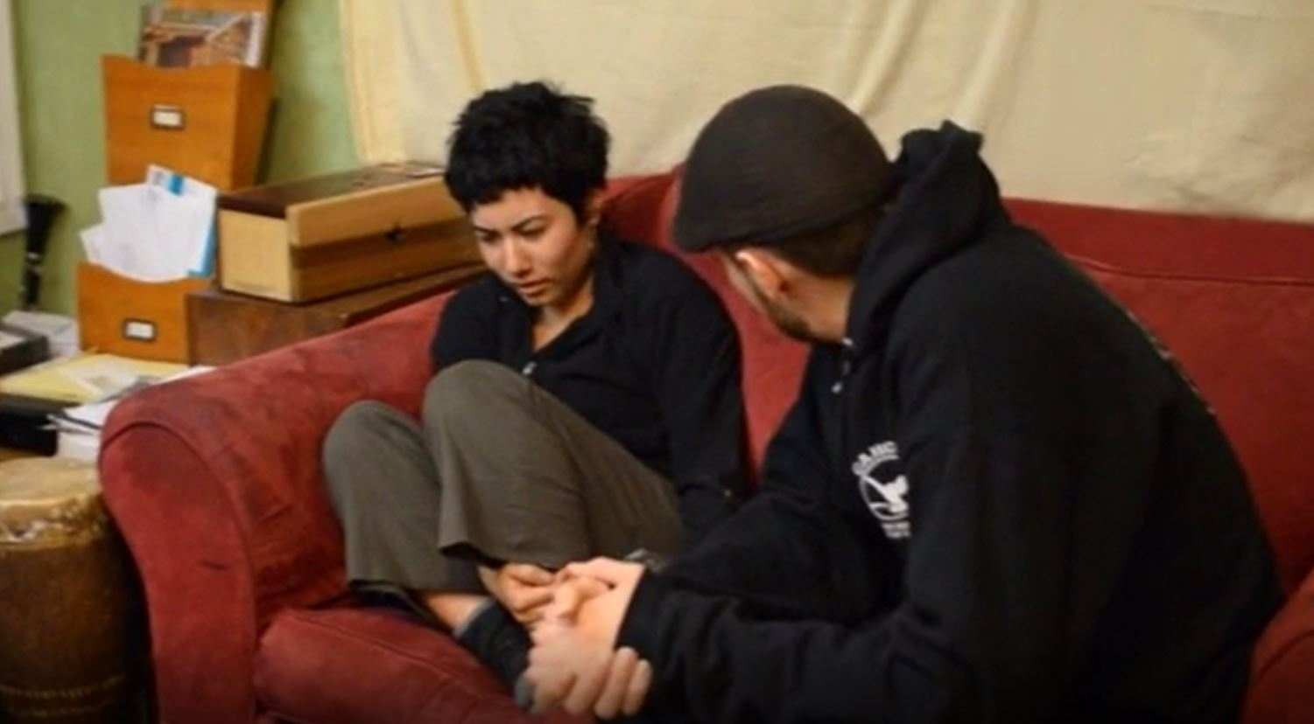

Slide 8
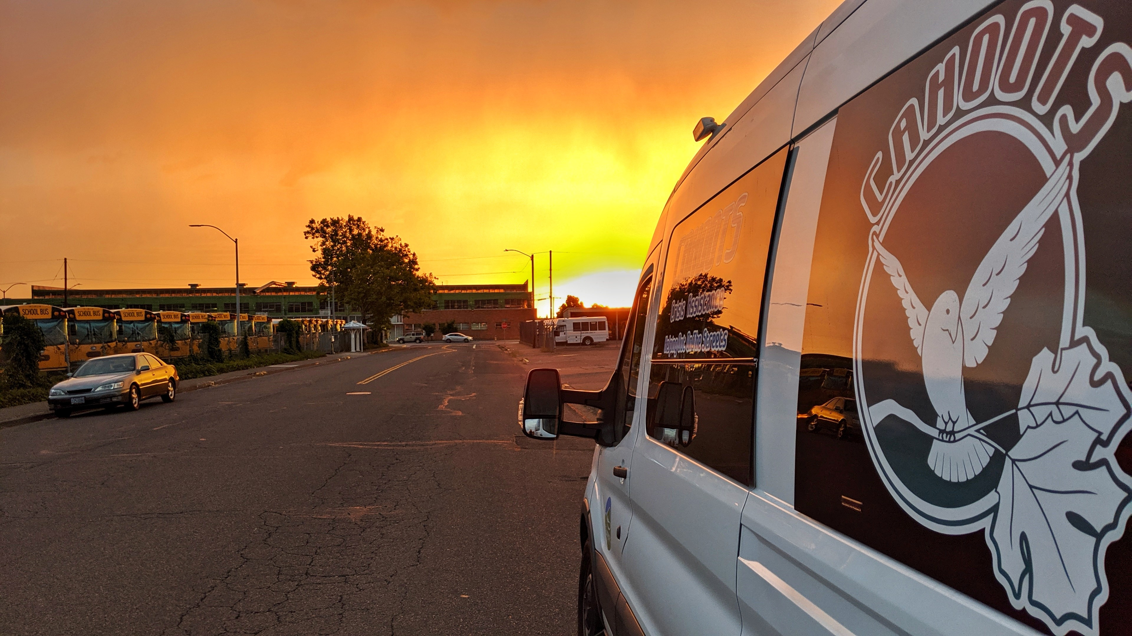

Slide 9
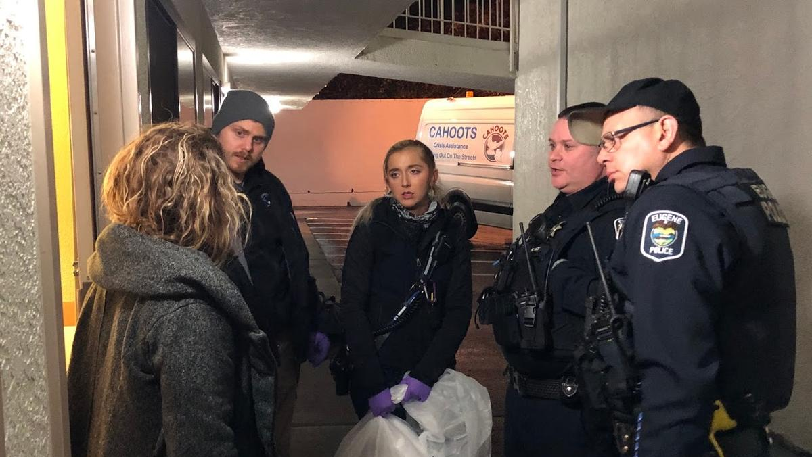
Photo Credit: Brian Bull, KLCC News

Slide 10
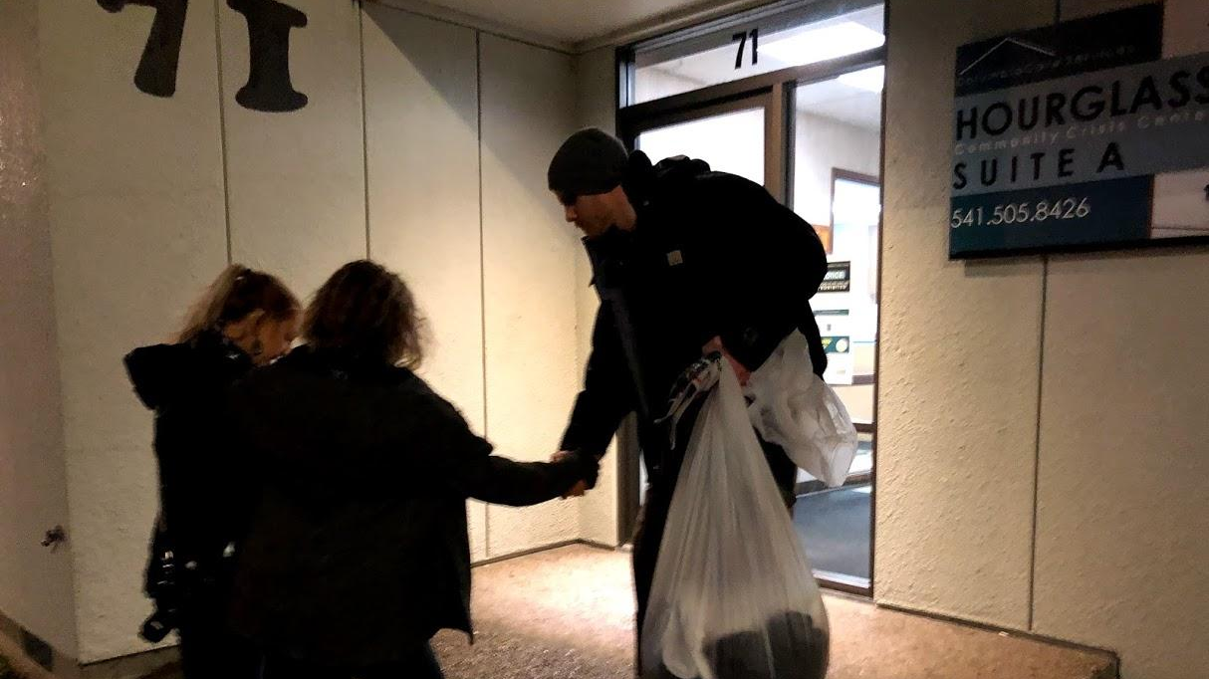
Photo Credit: Brian Bull, KLCC News

Slide 11
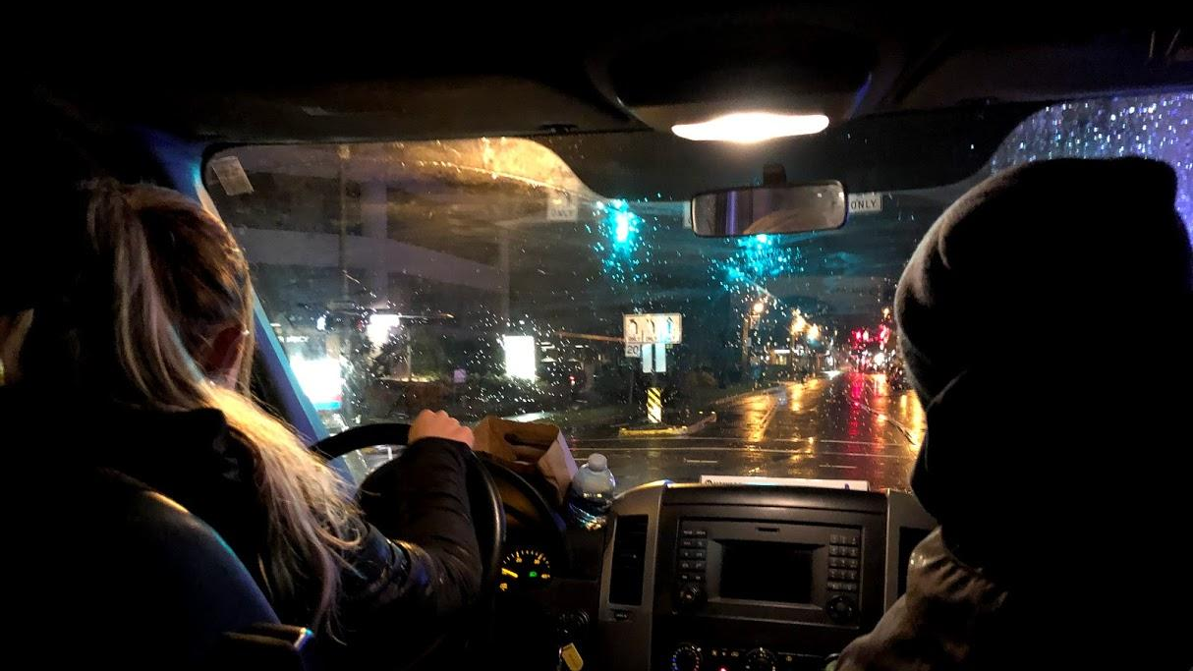
Photo Credit: Brian Bull, KLCC News

Slide 12
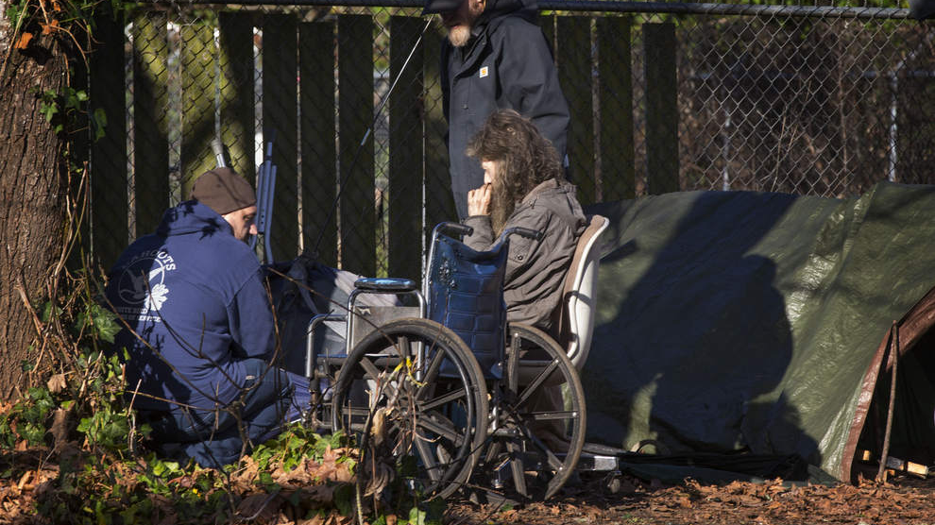
Photo Credit: Register Guard

Slide 14
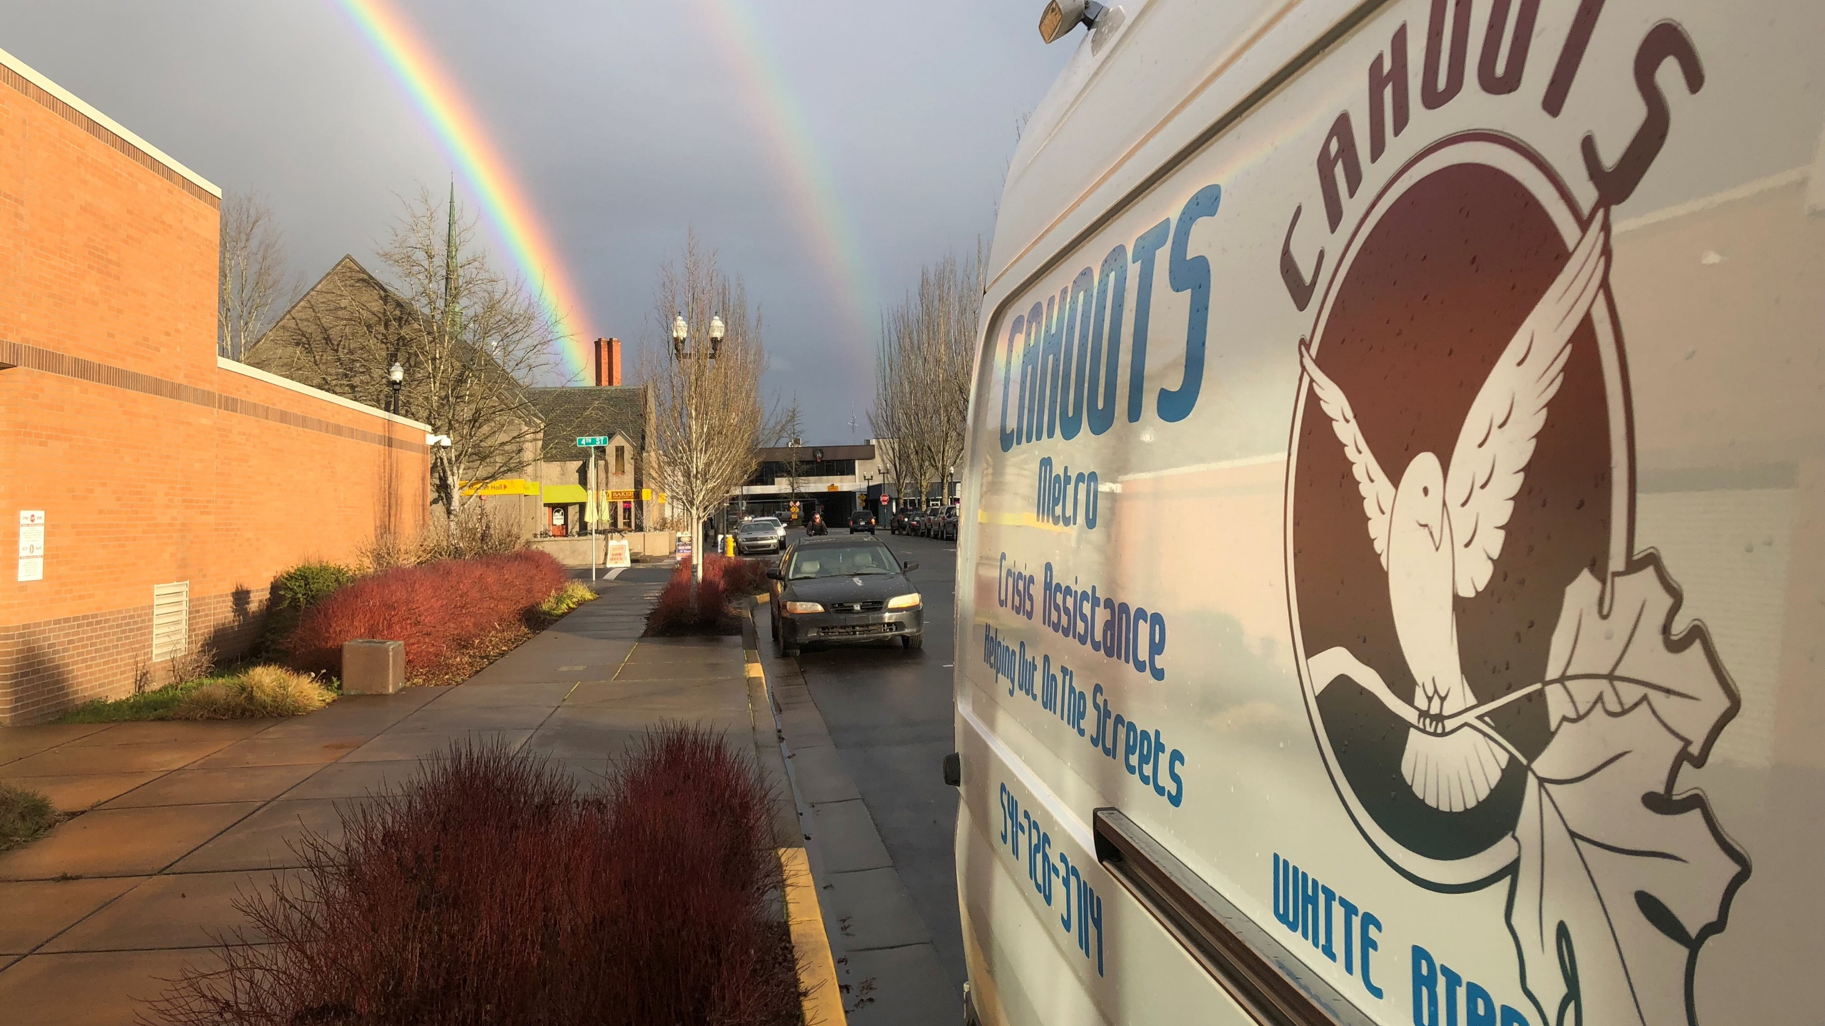

Slide 15
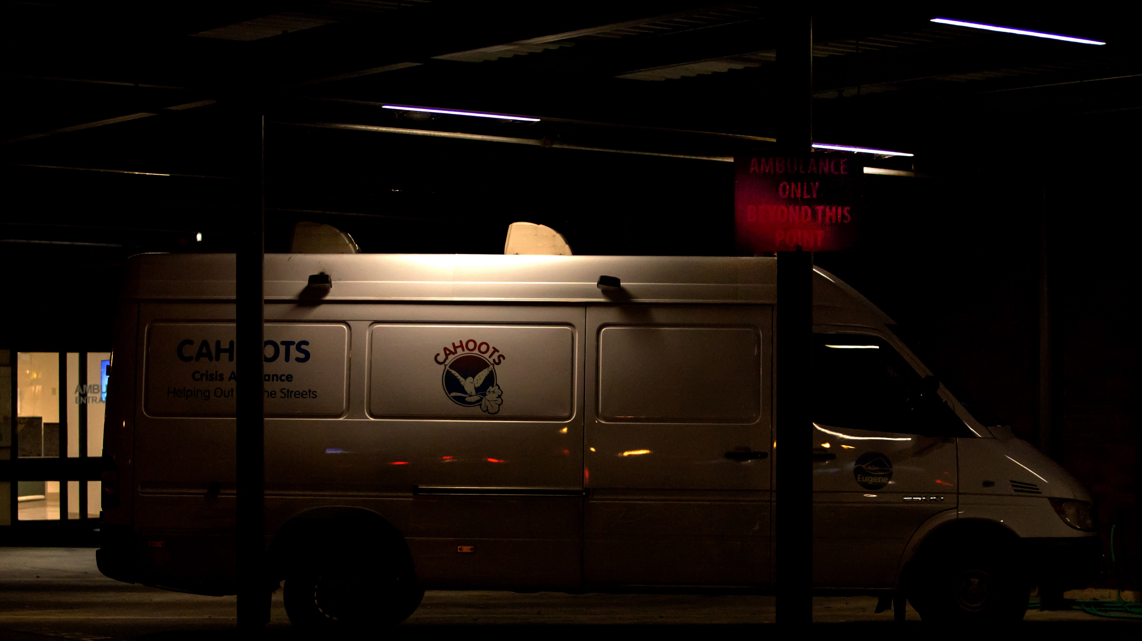
Photo Credit: Ben Lonergen

