Slide 1
NORTHWEST WORKERS’ JUSTICE PROJECT
PRESENTS
We Can Do Better: Worker Health and Safety

Slide 2
Presented by:
Kate Suisman
Attorney at:
Coalitions Manager of:

Slide 3
What is NWJP?
We are a non-profit law firm that:
Represents low-wage workers in employment disputes
Supports worker organizing efforts
Manages coalitions to strengthen workplace protections with a focus on legislative and administrative change
Provides worker education/training

Slide 4
What is Safe Jobs Oregon?
Safe Jobs Oregon is a coalition, run by NWJP.
The coalition is comprised of unions, worker organizations, academics and attorneys.
Prior to the pandemic, our priorities were:
Toxins/Chemicals at work
Sexual harassment and violence at work
Workers’ Compensation Reform
Heat stress

Slide 5
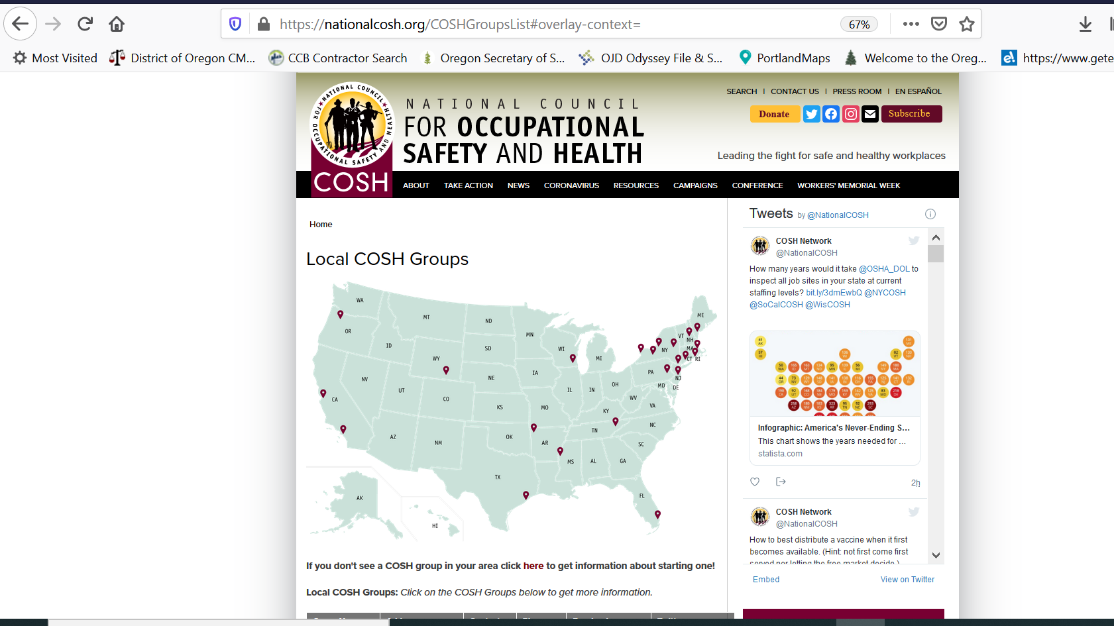
SJO is a member of the COSH Network- Council for Occupational Safety and Health

Slide 6
What problems are we trying to solve?
Higher rates of injury and illness for workers of color, especially immigrant workers.
This has been laid bare during the pandemic in Oregon and across the country.

Slide 7
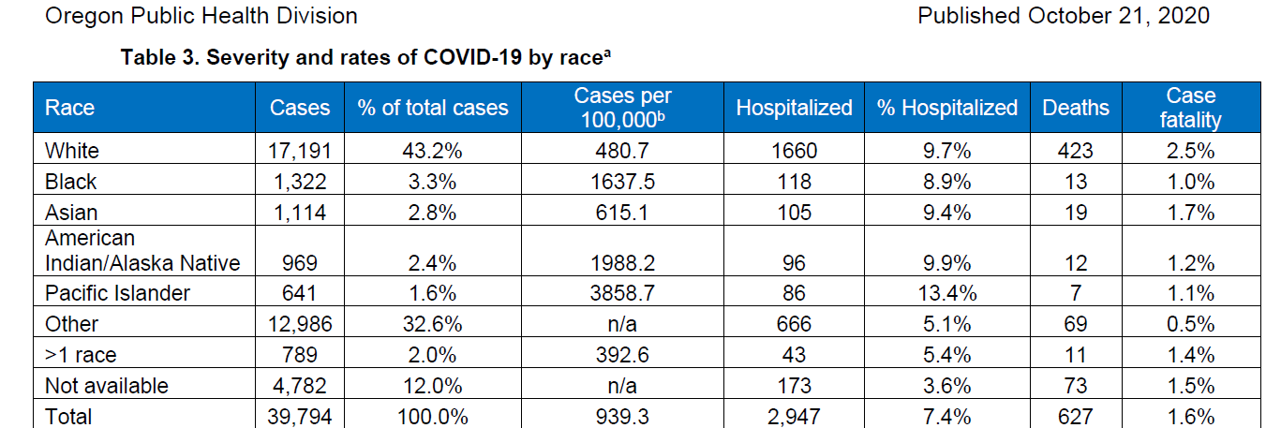
COVID-19 by race
Notes:
75% White state, 13% identify as Latinx

Slide 8
COVID-19 by ethnicity

Slide 9
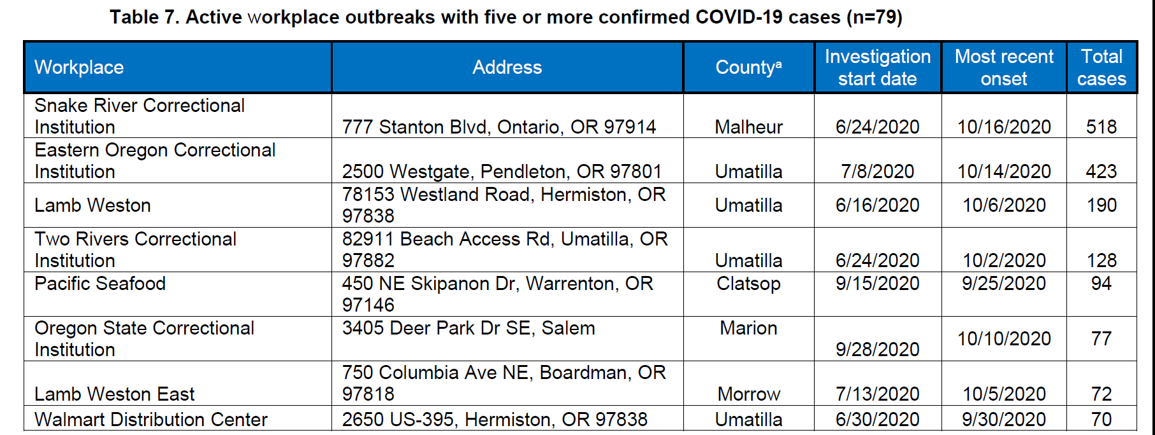
COVID-19 workplace outbreaks

Slide 10
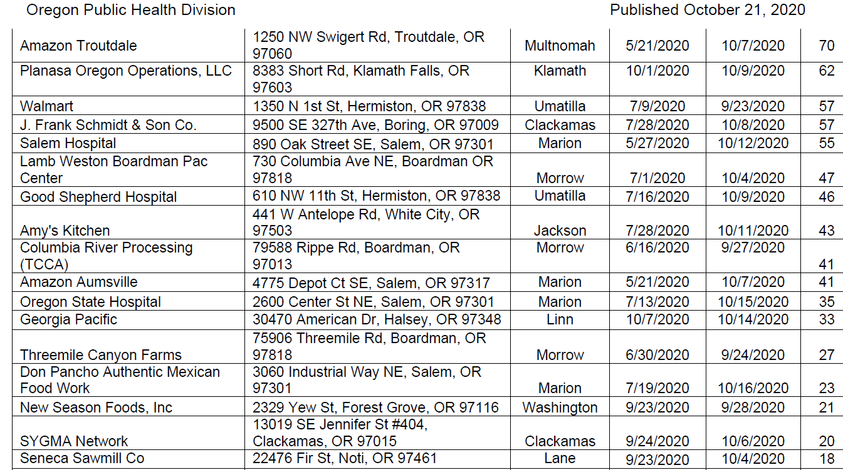
COVID-19 workplace outbreaks cont.
Notes:
Planasa is a nursery, schmidt is nursery, columbia is dairy

Slide 11
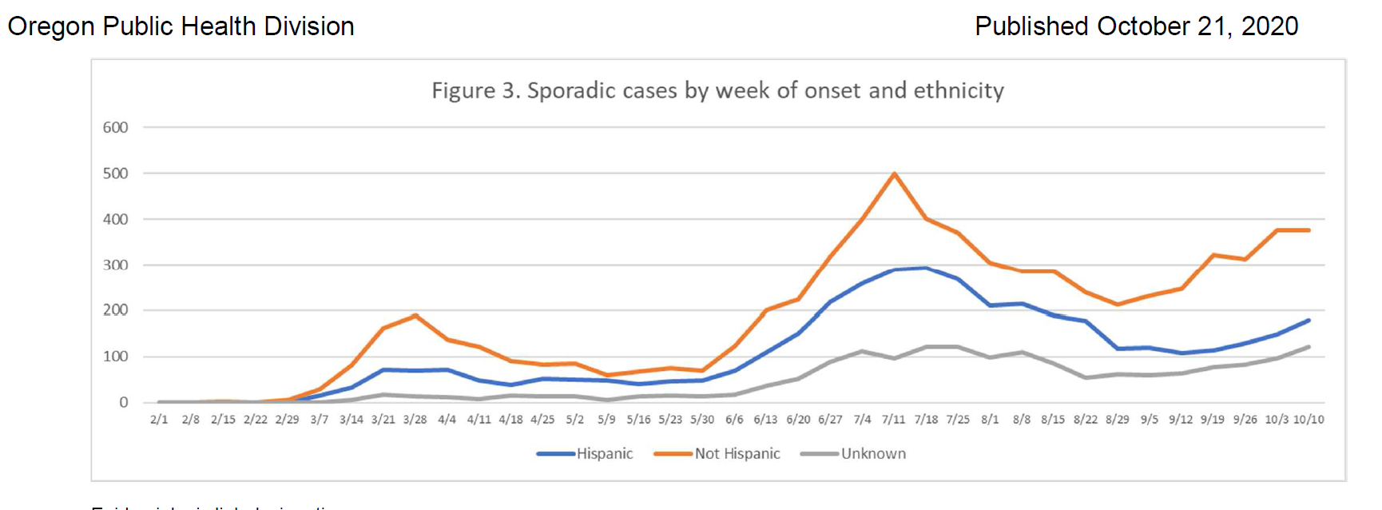
Spradic COVID-19 cases by ethnicity

Slide 12
Safe Jobs Oregon
Pandemic Priorities
Statewide, enforceable Oregon OSHA standard on COVID-19
Workers’ Compensation presumption for workers with COVID-19 where there is a workplace outbreak
Stronger whistleblower protections for workers who report dangerous conditions
Filling the gaps in federal sick leave, family leave and unemployment insurance.

Slide 13
How are we doing on those
Pandemic Priorities?
Statewide, enforceable Oregon OSHA infectious disease standard scheduled to go into effect week of November 2. (We will be the 3rd state with a standard.) This rule will be in effect for 6 months, at which time a permanent rule will go into effect.
cont. next slide

Slide 14
OR OSHA Infectious Disease Standard Details
OR OSHA has now put out four draft rules, each significantly stronger due to advocacy by our union partners and Safe Jobs Oregon
The most recent draft includes many of the things we have fought for including:
A written hazard assessment & infection control plan with worker input implementing hierarchy of controls;
meaningful training on covid transmission, symptoms, more; and
increased sanitation requirements.

Slide 15
Deficiencies in OR OSHA Infectious Disease Standard
Face shields are still allowed as face covering though they do not adequately protect against aerosol transmission. (In contrast to CDC which does not recommend face shields as substitute for masks.)
Transportation requirements were removed. These had limited the # of people in a vehicle to half capacity.
Overall, we can be proud of the rule.

Slide 16
Farmworkers
during the pandemic
OR-OSHA put a temporary rule into effect in April 2020 that:
Set square foot limits for how many people can sleep in employer-provided housing (though can use barriers to separate- not effective)
Increased the # of toilets required for agriculture workers
Increased sanitation requirements
Governor Brown extended these requirements by Executive Order last Friday, the day before they were set to expire.

Slide 17
Bottom Line
The reality of COVID-19 in Oregon:
Outbreaks are happening in indoor, crowded spaces with poor ventilation, where workers need to be spaced farther apart. These tend to be low-wage jobs with many immigrant workers and workers of color. The permanent infectious disease rule needs to address this reality.
TB

Slide 18
Those other priorities...briefly
Workers’ Compensation presumption has not happened yet but there was a hearing this week on a rule to require more investigation before denying claims-not a good enough fix.
Stronger whistleblower protections will be subject of a bill in 2021 session
Filling the gaps in sick, family leave, UI- New DCBS program “COVID-19 Temporary Paid Leave Program” if leave is exhausted or not provided; OWRF/OWQF
TB

Slide 19
What Can You Do?
Join NWJP’s mailing list, where we send out action alerts and updates on worker safety and health (as well as wage theft, discrimination...) nwjp.org
If your organization is interested in worker safety and health, join Safe Jobs Oregon. We meet infrequently but share information and support each other’s priorities. Email kate@nwjp.org
Attend the National Worker Safety and Health Conference in December: Info and registration at https://coshnetwork.org/
TB

Slide 20
Thank you!
Again, I’m Kate Suisman.
Contact me for more information:
Northwest Workers’ Justice Project (NWJP): 503-525-8454
kate@nwjp.org

